Slide 1
Date: 30/04/2022
Siamese Neural Network for One-Shot Image Recognition
Harshit Agarwal: 2019A3PS0245P
Sahil Agrawal: 2019A7PS0069P
Harshal Agrawal:: 2019A8PS0416P
Supervisor: Dr. Surekha Bhanot
TA: Preetika Verma

Slide 2
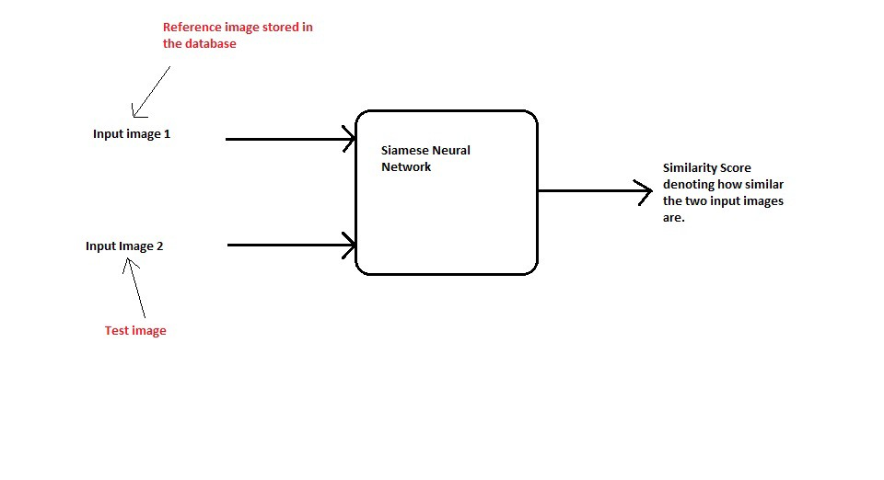
Author Affiliation
The authors are as follows:
●Gregory Koch
●Richard Zemel
●Ruslan Salakhutdinov
All authors are affiliated with Department of Computer Science, University of Toronto. Toronto, Ontario, Canada

Slide 3
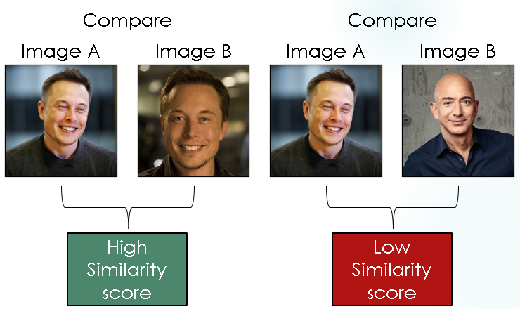
Paper Description: Aim
●Solving the one-shot classification
problem using siamese neural-networks
●Applying a structure to naturally
rank similarity between inputs.
●Training the network model to able to
identify various different classes by
providing just a single training example.
●Making model was able to outperform
Other deep-learning models on one-shot classification tasks.

Slide 4
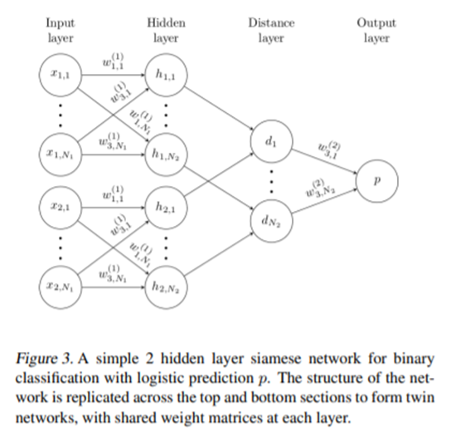
Paper Overview: Methodology
●Our standard model is a siamese convolutional neural network with L layers each consisting of N_{l} units,where the hidden vector in layer l for the first twin is represented by h_{1,l} and similarly as h_{2,l} for the second twin.

Slide 5
Paper Overview: Methodology
●The model is composed of a sequence of convolutional layers, and each layer uses a single channel with varying filter sizes and a fixed stride of one.
●The units in the final convolutional layer are flattened into a single vector. This convolutional layer is followed by a fully-connected layer, and then one more layer computing the induced distance metric between each siamese twin, which is given to a single sigmoidal output unit.

Slide 6
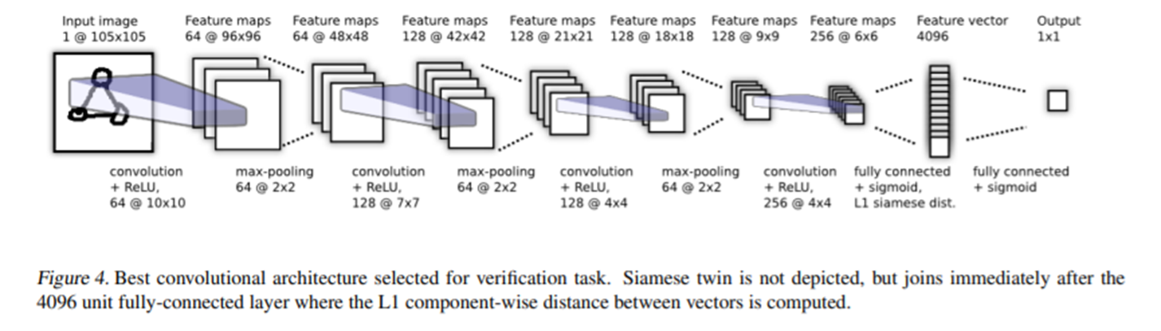
Overview of the model

Slide 7
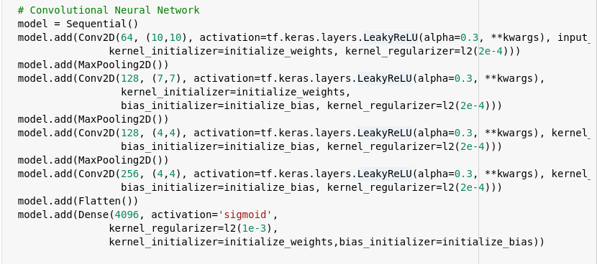

Slide 8
Paper Overview : Outcome
The proposed architecture managed to accomplish the one-shot classification task of being able to identify classes using just one training example.
The model outperforms all available baselines by a significant margin and also achieves and accuracy very close to human-level (95.5%).

Slide 9
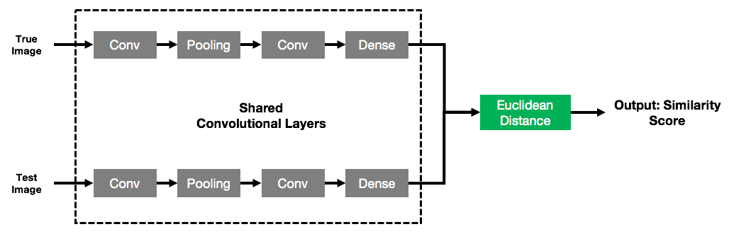
Background Concepts
Siamese Neural Network: A Siamese neural network consists of two identical subnetworks, a.k.a. twin networks, joined at their outputs. Not only the twin networks have identical architecture, but they also share weights.

Slide 10
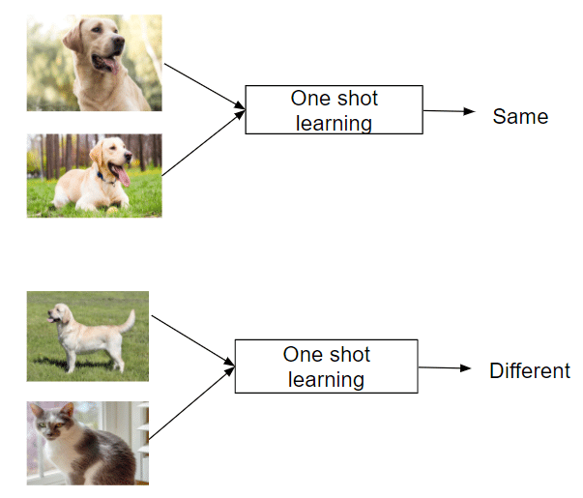
Background Concepts
One-shot Learning: It is a classification
task which involves predicting
the label for an example after providing
just one training example for a specific class.

Slide 11
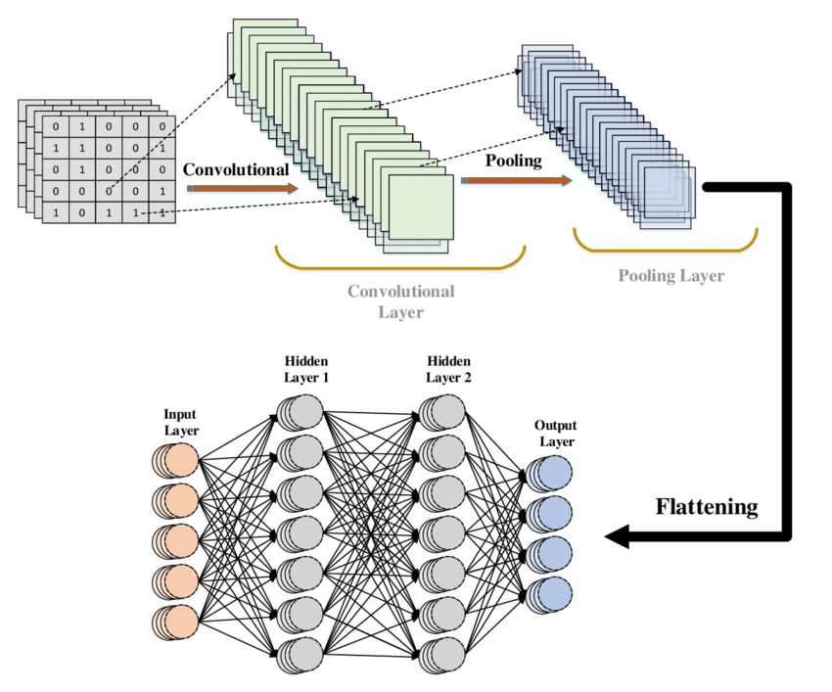
Background Concepts
Convolutional Neural Network (CNN):
A convolutional neural network, or CNN,
is a deep learning neural network designed
for processing structured arrays of data
such as images.
Max-pooling: Max pooling is a pooling
operation that selects the maximum
element from the region of the feature
map covered by the filter.

Slide 12
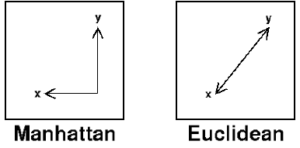
Background Concepts
L1 Distance (Manhattan Distance): Also known as Manhattan Distance or Taxicab norm. L1 Norm is the sum of the magnitudes of the vectors in a space. It is the sum of absolute difference of the components of the vectors.

Slide 13
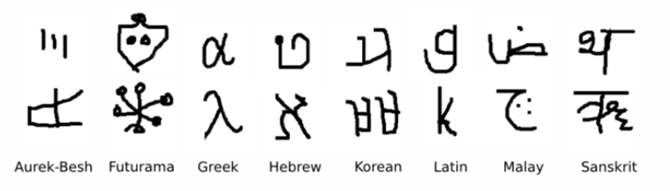
Dataset Details : Omniglot
The Omniglot data set was collected by Brenden Lake and his collaborators at MIT via Amazon’s Mechanical Turk to produce a standard benchmark for learning from few examples in the handwritten character recognition domain .
It contains examples from 50 alphabets ranging from well-established international languages like Greek and Sanskrit to lesser known local dialects.

Slide 14
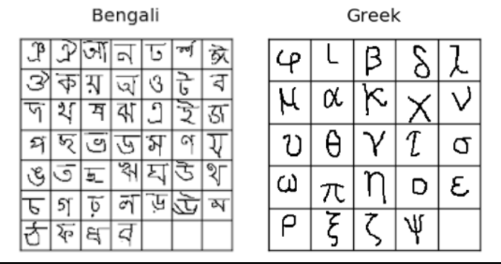
Dataset Details : Omniglot
The number of letters in each alphabet varies considerably from about 15 to upwards of 40 characters.
The background set is used
for developing a model by
learning hyperparameters
and feature mappings while
the evaluation set is used
only to measure the one-shot
classification performance.

Slide 15
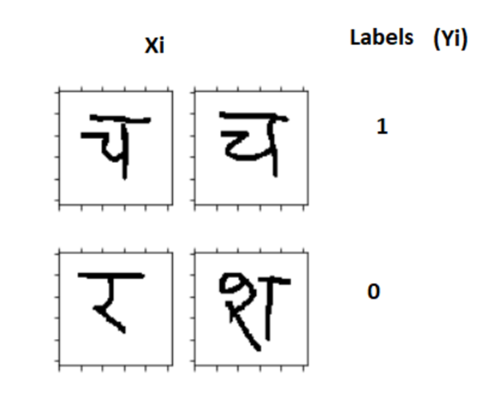
Implementation Details : Data Pre-processing
Firstly, we loaded the images by first looping over all the languages and fetching all the images for each alphabet in every language one by one. This was done for both test and validation sets.
Then we randomly selected languages for each batch and in every language, formed pairs of images with target of 1 if they belong to the same alphabet and 0 if they are of different alphabets.

Slide 16
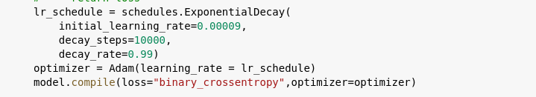
Architecture and Training
The two input images (x1 and x2) are passed through a ConvNet to generate a fixed length feature vector for each (h(x1) and h(x2)).
The L1 distance between the feature vectors is then used to compute a similarity score which determines the final class.
We used Adam Optimizer with a learning rate of 0.00009 exponentially decaying at a rate of 0.99 and binary cross-entropy loss.
The model was trained for 2000 epochs with a batch size of 32.

Slide 17
Validation and Testing
N-way One-shot Learning has been used to validate and test the data.
For each alphabet, a test image and a support set is generated randomly from the validation set. The test image is then compared to each of the images in the support set and the pair with the maximum similarity is used to determine the accuracy.
If the image with the maximum similarity is the correct one, we consider it as correct and increase the number of correctly classified examples.

Slide 18
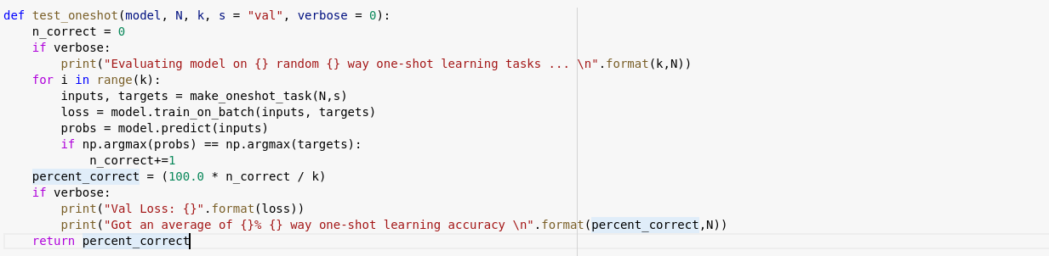

Slide 19
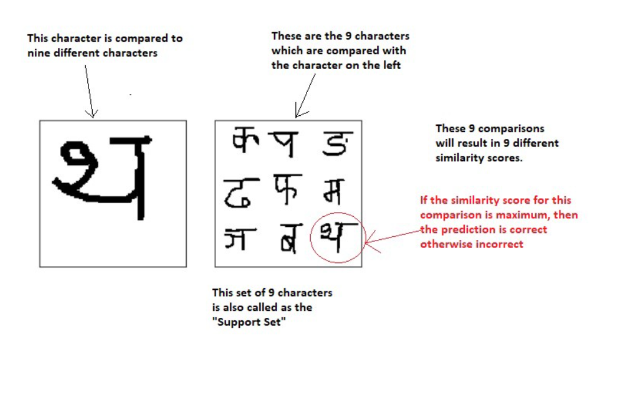

Slide 20
Results and Discussion
Initially, the accuracy was not that high (~80%). However, after changing the activation functions, we were able to achieve accuracy of of 90.4%.
Activation Function | Accuracy
ReLU | 80%
Leaky ReLU | 89.2%
SELU | 90.4%

Slide 21
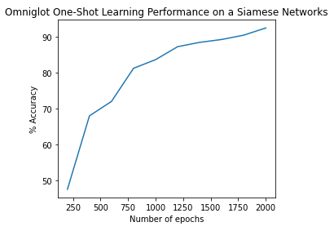
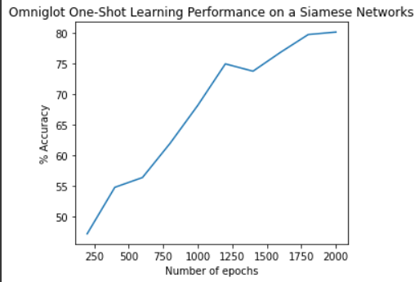
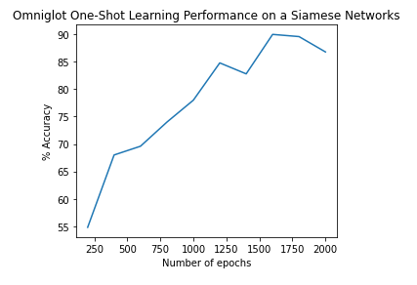
Results and Discussion
Leaky RELU
SELU
RELU

Slide 22
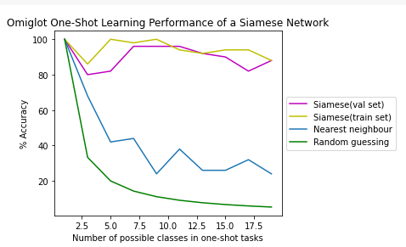
Results and Discussion
We also plotted the accuracy for a Nearest Neighbour classifier and a Random Model using L2 distance on the same dataset and compared it with our model.

Slide 23
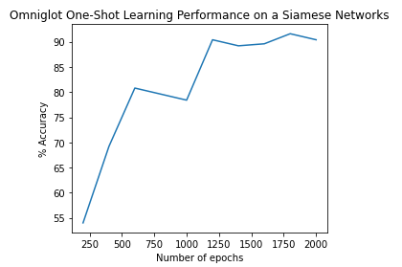
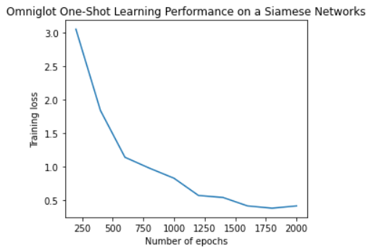
Results and Discussion
We also changed the learning rate from 0.00006 to 0.00009 and added a decay rate of 0.99. By this, we were able to achieve an accuracy of 91.6%.
SELU

Slide 24
Challenges Faced
We initially found the dataset a bit hard to manipulate as it was quite large. However, with the help of a few articles online we were able to write the functions to extract the dataset and split the data into pairs.
The complex architecture of Siamese Networks was slightly hard to comprehend and we required other additional resources to completely understand the concept.
None of us had prior Deep Learning experience and had to learn Tensorflow/Keras from scratch.

Slide 25
Future Scope
Instead of using binary cross-entropy, alternate loss functions like triplet and contrastive loss can be used which may give better results.
The one-shot classification model can be extended to 3D RGB images and used for applications like face recognition and verification.
Various data augmentation techniques like changing contrast, adding noise and random choosing can be tried.
Many of the hyper-parameters can be further tuned or a software like Whetlab can be used for further optimization.

Slide 26
Experience/Learning Outcome
We learnt to use Tensorflow/Keras and applied Deep Learning techniques like CNN.
Learnt to use Python libraries like Pickle, Matplotlib, etc.
Understood hyperparameter optimization and tuned various hyperparameters to increase the accuracy.
Read about various new activation functions like SeLU which can be used as substitutes for ReLU.
We also learnt how to read research papers end-to-end and replicate the results by ourselves.

Slide 27
Thank You

